Slide 1
BE RESILIENT
We’ll get through this together

Slide 2

Purpose of Theory
Events/Phenomena
Explain
Influence
Predict

Slide 3
Stakeholder Mapping

Slide 4
Glassell University has established objectives to increase its student population to over 10,000 students. Please develop a stakeholder map that integrates pertinent stakeholders.

Slide 5
Problems with Strategic Planning
Unrealistic forecasts lead to over-optimistic strategic plans
Arbitrary goals have no support within the strategic plan
There is no shared vision (A Cautionary Tale)
Planning is an event rather that a process
A department that is not responsible for implementation develops strategic plans
Decisions about strategy neglect to integrate key organizational stake holders

Slide 6
Strategic Planning (SWOT)
Internal Assessment | Strengths Where can we outperform others | Weaknesses Where others can outperform us
External Assessment | Opportunities How we might exploit the market | Threats What/who might take our market

Slide 7
Strategic Inquiry to Appreciative Intent (SOAR)
Strategic Inquiry | Strengths What are our greatest assets | Opportunities What are the best possible market opportunities
Appreciative Intent | Aspirations What is our preferred future | Results What are the measurable results

Slide 8
Strategic Inquiry
How is appreciative thinking different from the traditional approach to strategic planning?
What do the authors mean by “enabling objectives?” Enabling what or whom?

Slide 9
Strategic Inquiry
How would you assume that all stakeholders genuinely contribute to the SOAR process?

Slide 10


Slide 11





Kouzes, J. M. and B. Z. Posner (2006). The leadership challenge, John Wiley & Sons.

Slide 12
What are the elements of persuasion?

Slide 13



Pathos
Think Pathos = Passion
The pathos appeal plays
on your emotions.
Ethos
Think Ethos = Expert
Trust me, I'm an
expert at this
Logos
Think Logos = Logic
Numbers, facts, polls,
studies, etc.

Slide 14
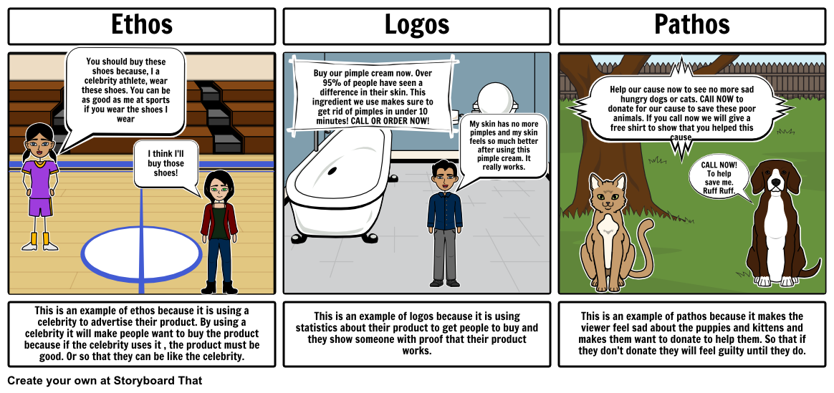

Slide 15
LEAD 101
Principles and Practices of Leadership
Unit 5

Slide 16
Exploring the History of Leadership Studies
Developing a Personal Leadership Philosophy
Realizing Change
Leading by Serving
Making Decisions
Guiding Through Conflict
Articulating a Vision
Building a Team

Slide 18
“Individual commitment to a group effort—
that is what makes a team work, a company
work, a society work, a civilization work.”
“People who work together will win,
whether it be against complex football defenses, or the problems of
modern society.”
—Vince Lombardi
Notes:
Vince Lombardi (1913 – 1970)
Green Bay Packers Head Coach 1959 – 1967
To start this unit, Participants can scan the excerpt from the Grapes of Wrath and highlight or underline words they come across that relate to groups/teams. They’ll be surprised how many they identify. The excerpt illustrates the principles of team building listed on the next slide.

Slide 19
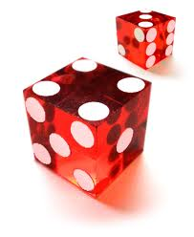
Risk

Slide 20
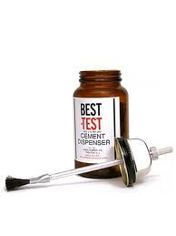
Cohesion

Slide 21
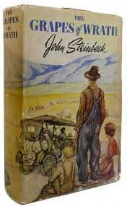
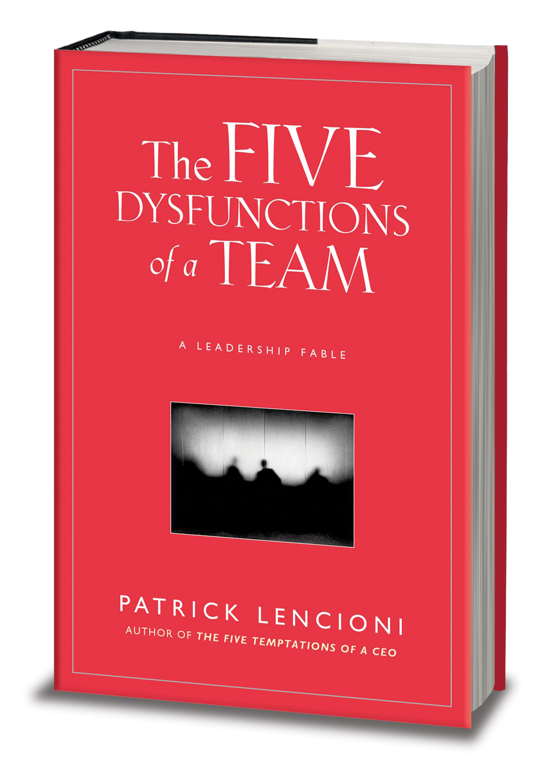

Slide 22
1929 -1939

Slide 23
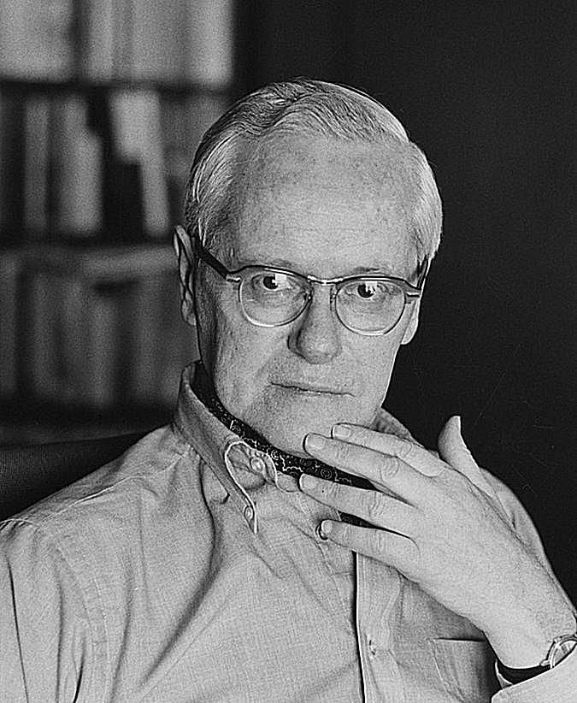
A cautionary tale
Unintended consequences

Slide 24
Y = C + I + G

Slide 25
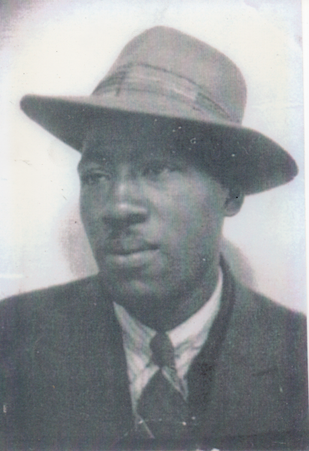

Slide 26
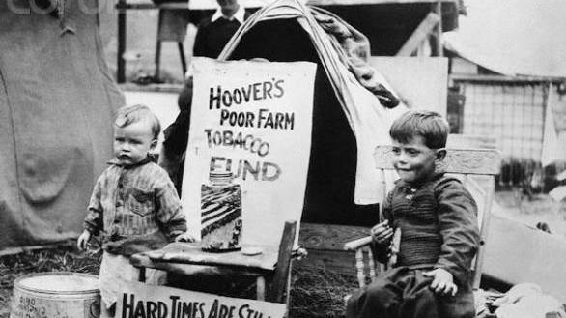

Slide 27
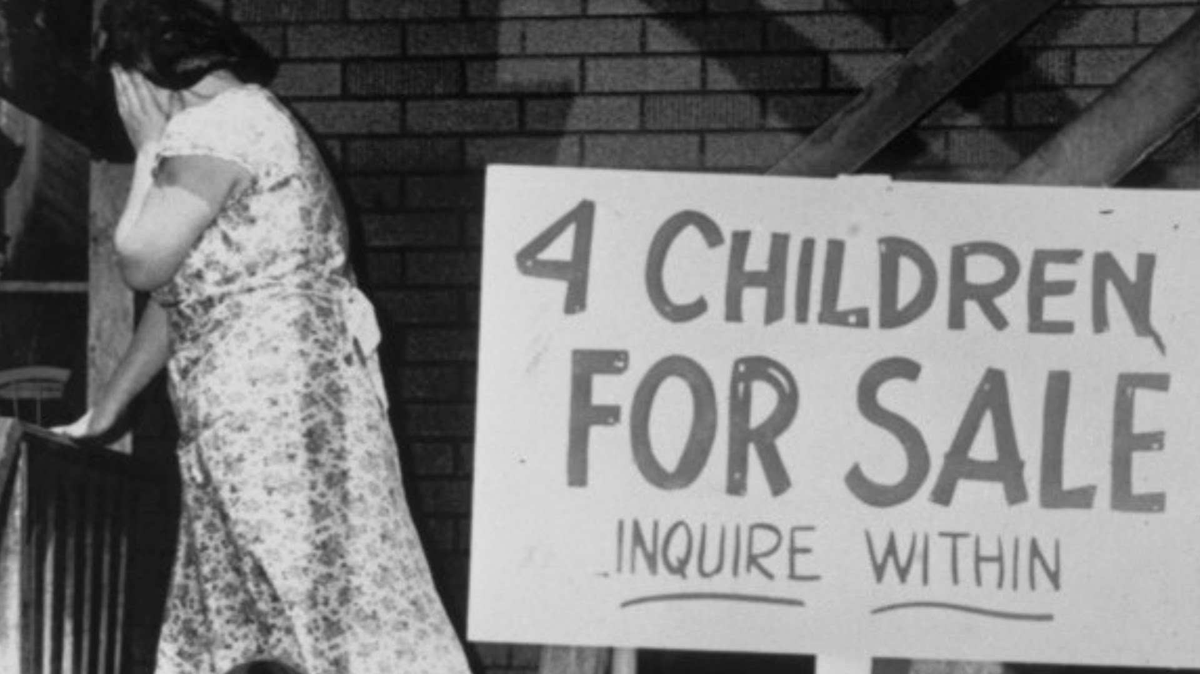

Slide 28
https://video.nationalgeographic.com/video/news/ken-burns-dust-bowl-vin

Slide 29
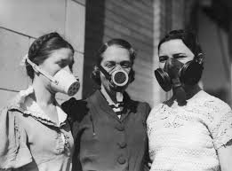

Slide 30
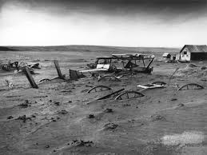

Slide 31
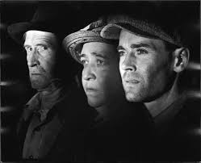

Slide 32
The Grapes of Wrath
Becoming teams to create “worlds”
Cooperation
Common, shared purpose and goal
Strengthened through asserting common values, rules, and regulations
Socializing—sharing sorrows and joys important
Common vulnerability
Future oriented
Equality among members
Notes:
Before beginning the dialogue or small group work about the excerpt, play the 1-minute classic. Typical for students to want the “quick and dirty” version of classic readings in this (or a history or literature) curriculum – the “cliff’s notes” – but they won’t learn anything this way. The 1-minute classic illustrates this well – it’s tough to absorb anything.

Slide 33
Dialogue
How are Steinbeck’s principles related to team building relevant to modern organizations?
How does Steinbeck suggest that groups incorporate newcomers effectively?

Slide 34
LEAD 101
Principles and Practices of Leadership
Unit 5

Slide 35
Exploring the History of Leadership Studies
Developing a Personal Leadership Philosophy
Realizing Change
Leading by Serving
Making Decisions
Guiding Through Conflict
Articulating a Vision
Building a Team

Slide 36


Team Collaboration
The Fab Five Learning Model
(The Fab Five “Bee”haviors of Collaboration)
RESPECT
others’ time and contributions
COURAGE
to speak up, voice different viewpoints and take risks
TRUST
each others’ intentions
LEARNING
to process events acquire knowledge and adapt
COMMUNICATE
honestly and openly with each other
COMMITMENT
to project goals and to our team
FOCUS
by making decisions and moving on

Slide 37
The Secrets of Great Groups
At the heart of every
Great Group is a shared dream.
They manage conflict
by abandoning
individual egos to the
pursuit of the dream.
They are protected
from the “suits.”
They have a real or
invented enemy.
They view themselves
as winning underdogs.
Members pay a
personal price.
Great Groups make
strong leaders.
Great Groups are the product of meticulous recruiting.
Great Groups are
usually young.
Real artists ship.
Warren Bennis
Notes:
Be sure everyone understands what Bennis means by each of these things,
Especially 3, 4 (doesn’t have to be a person, for an educator it could be “ignorance”, can also be imaginary like the chapter who talks about “chompy” “the anti-Phi Theta Kappan”, or the concept of “haters” -- people who don’t want what you want), 7 (teamwork empowers all of them), and 10
In small groups, or as a large group, participants can review this list and conduct a shared analysis with the Grapes of Wrath

Slide 38
Behavioral Traits of
Great Groups’ Leaders
They provide direction and meaning
They generate and sustain trust
They display a bias toward action,
risk taking, and curiosity
They are purveyors of hope
Warren Bennis
Notes:
Bennis gives the examples of Great Groups: the Manhattan Project, Xerox’s Palo Alto Research Center, Apple Computer, Lockheed Skunk Works, and Walt Disney animators.
Ask the students to think of additional great groups, and the leaders of great groups
View the clip from Remember the Titans. Is Coach Boone doing any of these things?
Clip length – 0:05:50
In DVD chapter 8 Start at 0:28:10 (toward end of a grueling practice)
End 0:34:00 (end of Coach Boone’s speech at Gettysburg)

Slide 39
Dialogue Questions
Bennis asserts that a “Great Group” cannot be managed. Why not?
Why is youth important to have a Great Group? Do you agree?

Slide 40
Five Team Dysfunctions
Inattention to RESULTS
Avoidance of ACCOUNTABILITY
Lack of
COMMITMENT
Fear of
CONFLICT
Absence of
TRUST
Patrick Lencioni

Slide 41
Dialogue Questions
How can trust be established in a group when time is short and the group must deliver results?
Do teams make sense for very large organizations? For very small ones? Why or why not?

Slide 42
Developmental Sequence in Groups
Forming
  Awkward, primary tension
  Socialization
Storming
  Secondary tension
Norming
Performing
Adjourning (added later in 1977)
Bruce Tuckman
Notes:
Grapes of Wrath also illustrates the sequence of group development that Bruce Tuckman identified --

Slide 43


Slide 44


Slide 45
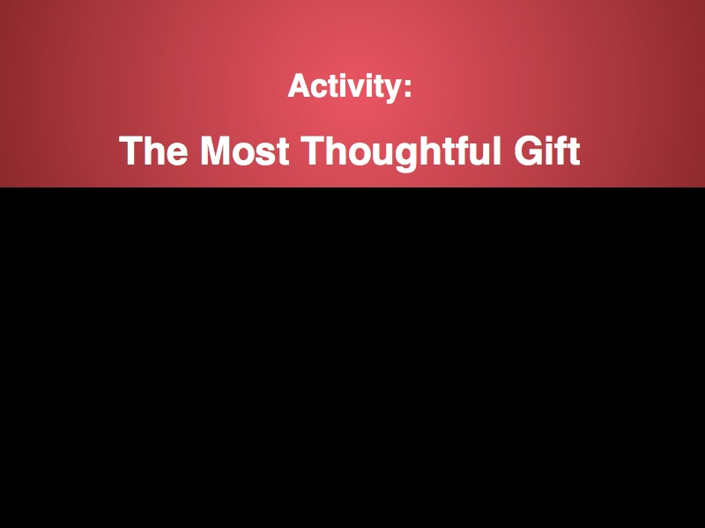

Slide 46
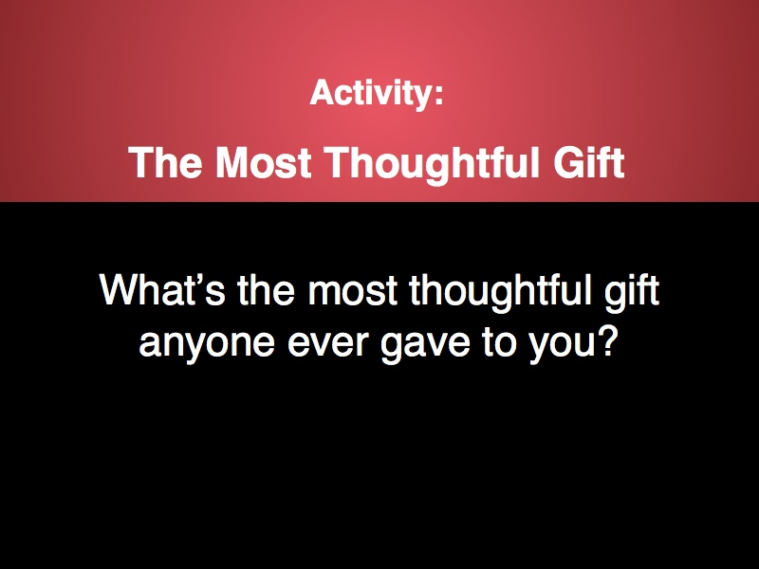

Slide 47
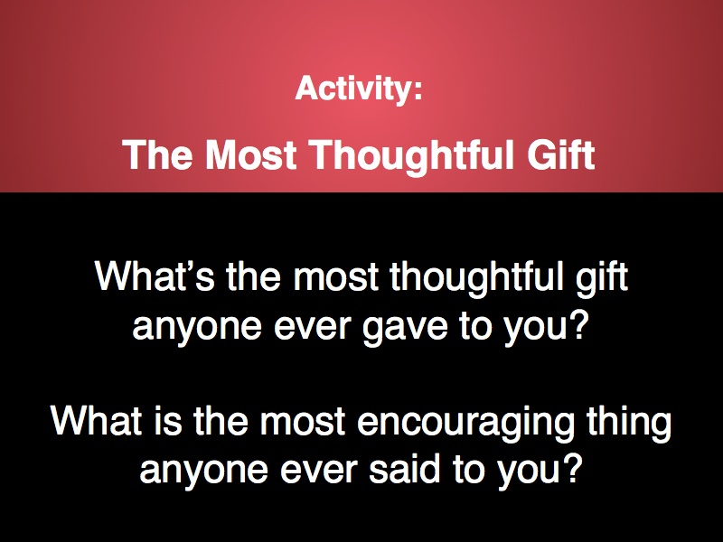

Slide 48


Slide 49


Slide 50


Slide 51
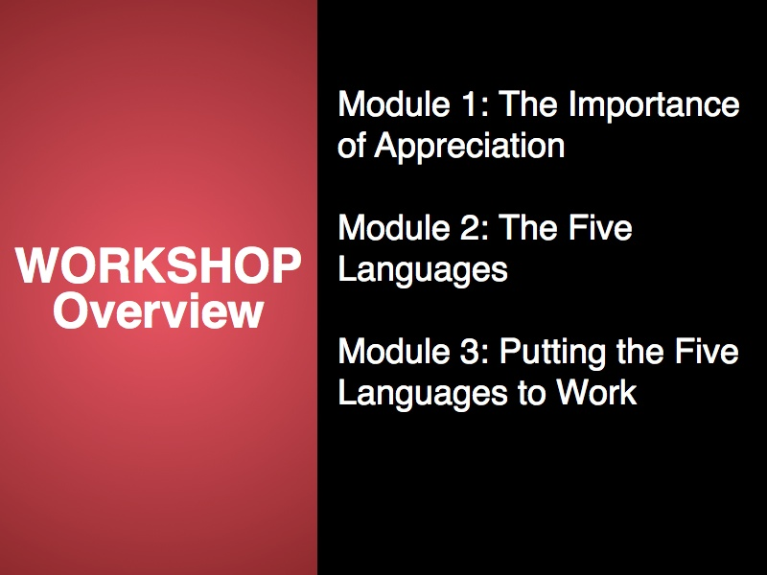

Slide 52
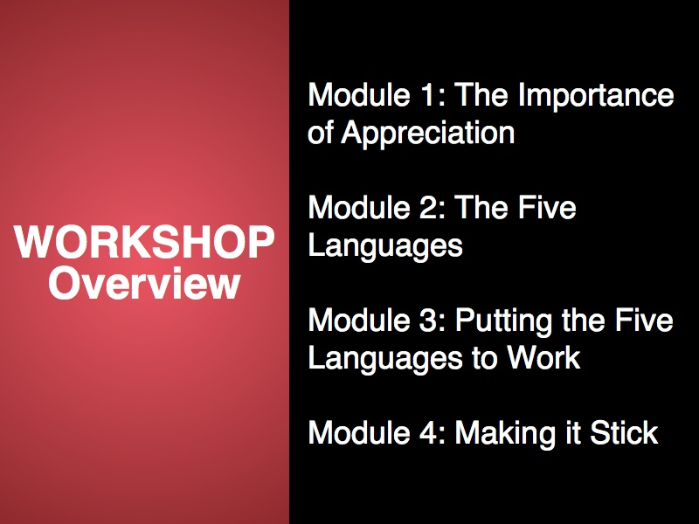

Slide 53


Slide 54


Slide 55


Slide 56


Slide 57


Slide 58
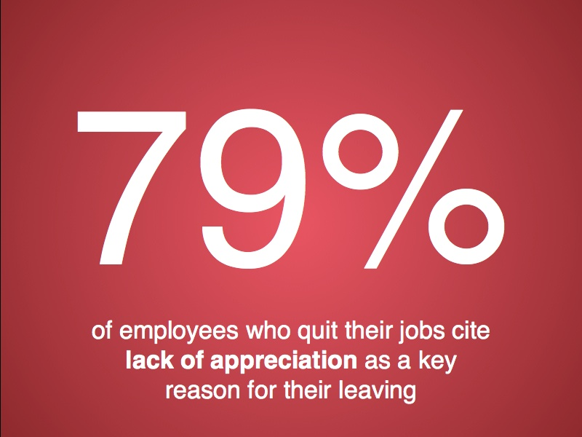

Slide 59
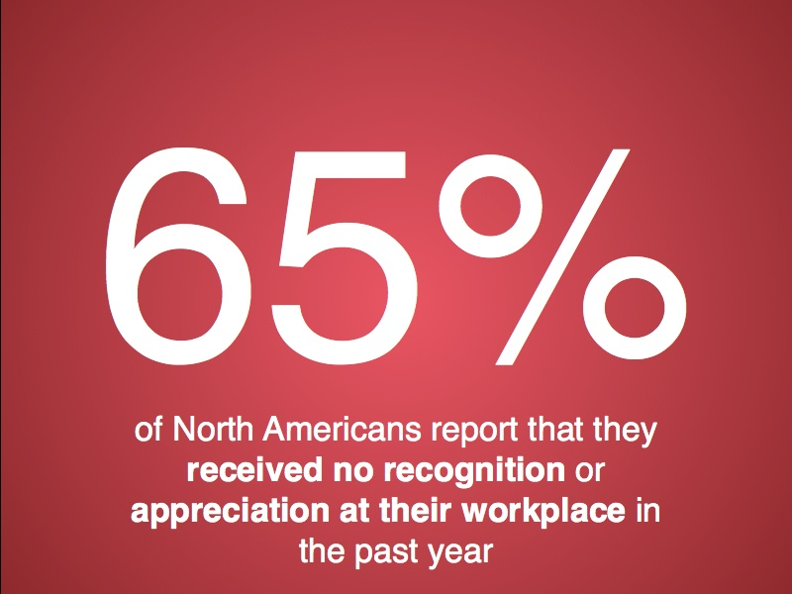

Slide 60


Slide 61
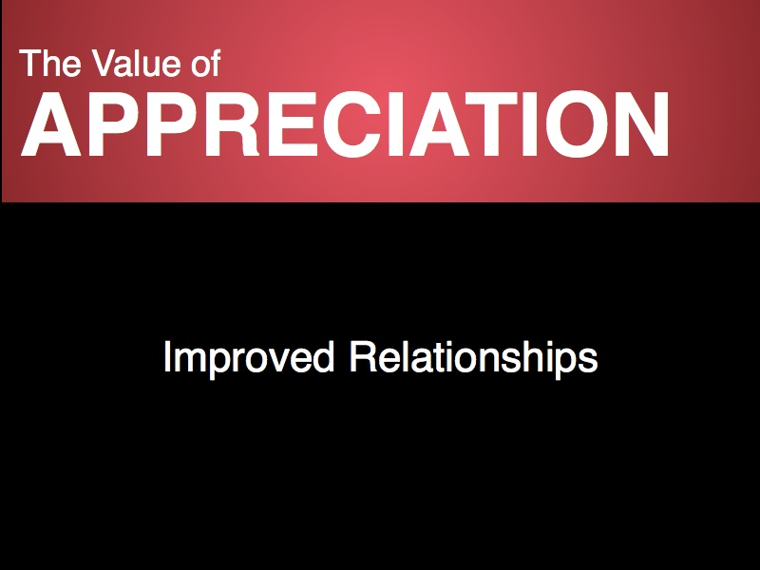

Slide 62
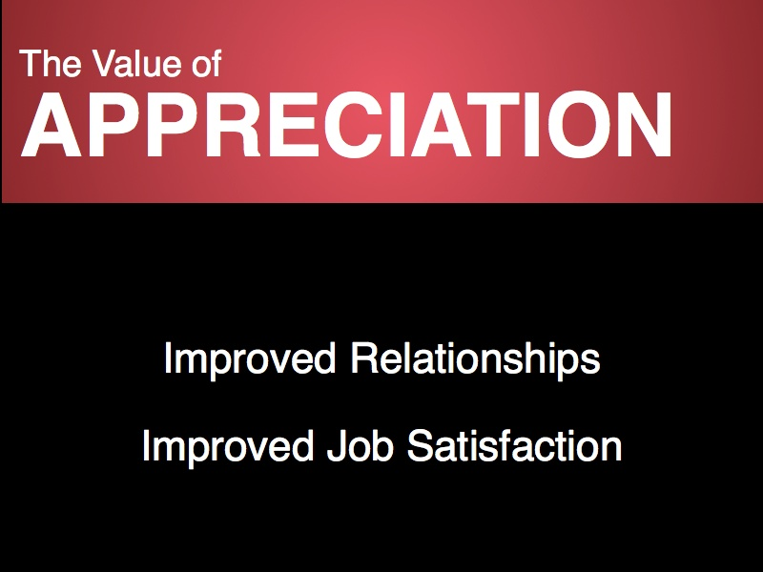

Slide 63


Slide 64
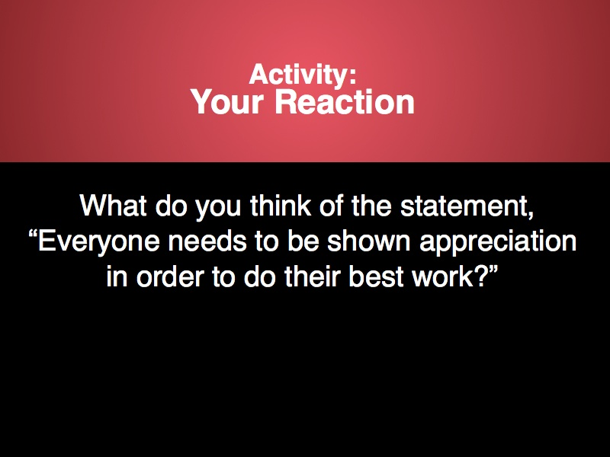

Slide 65
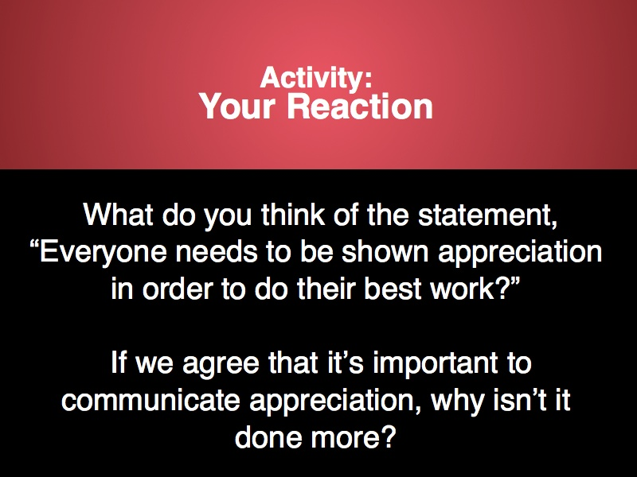

Slide 66


Slide 67
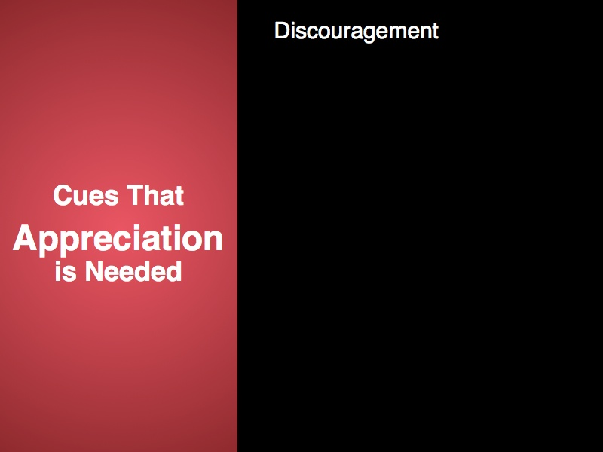

Slide 68
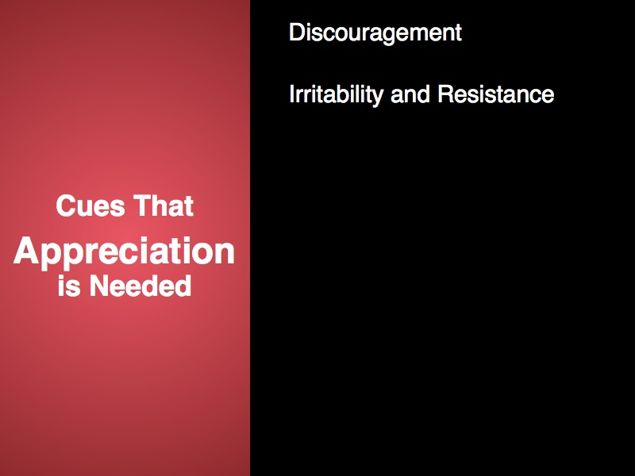

Slide 69
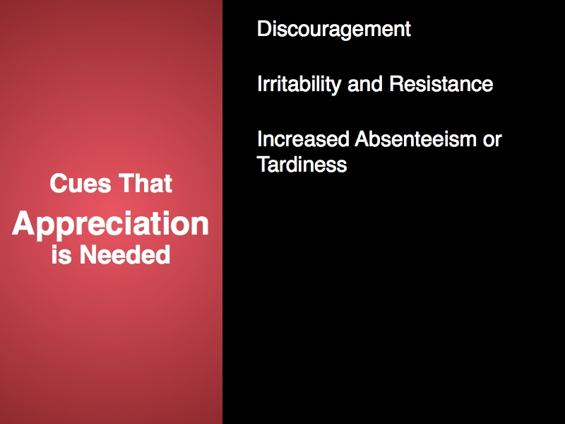

Slide 70
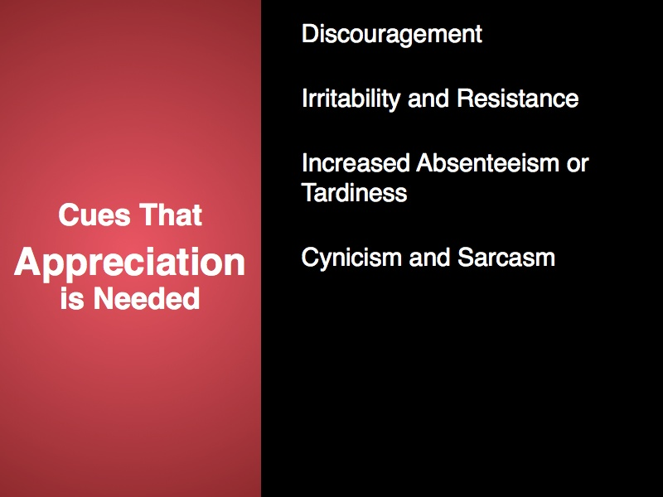

Slide 71
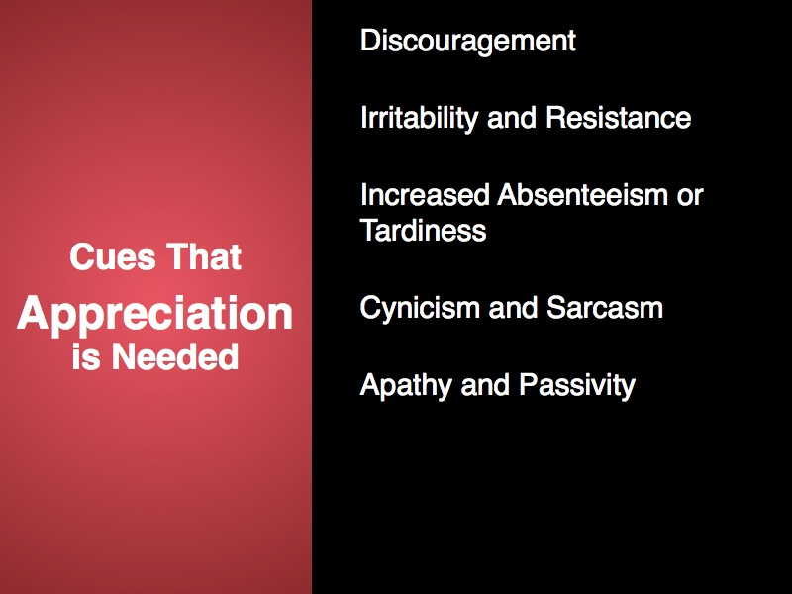

Slide 72
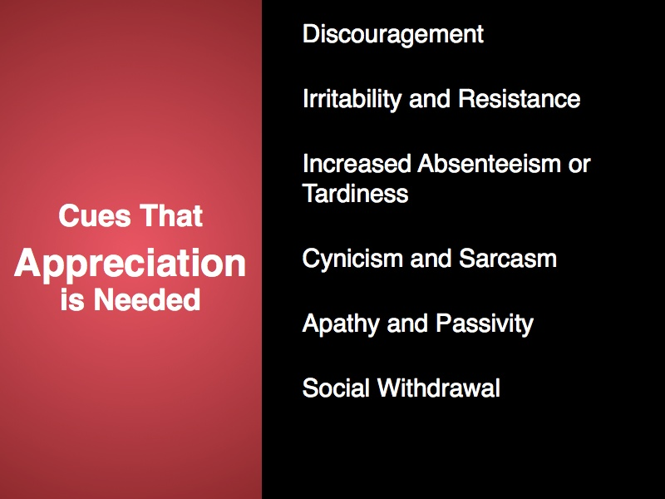

Slide 73
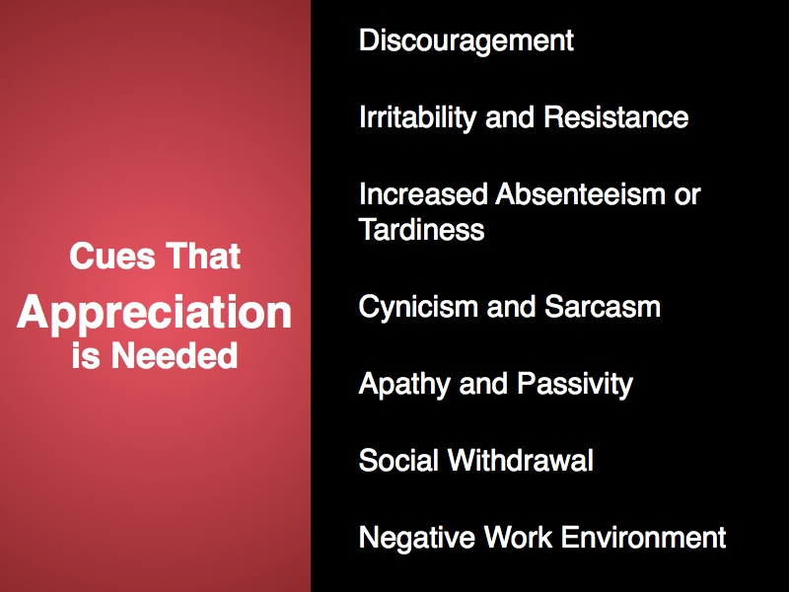

Slide 74
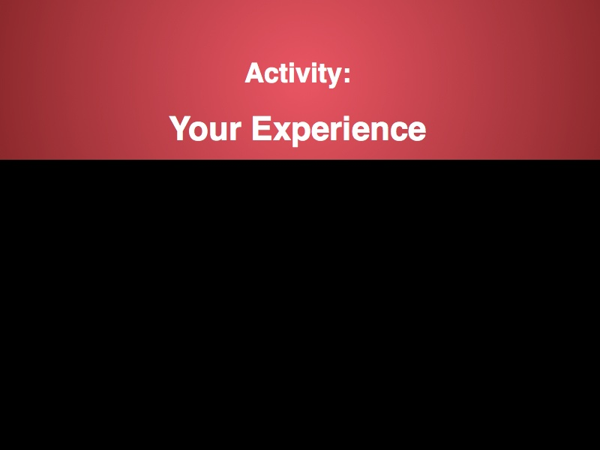

Slide 75
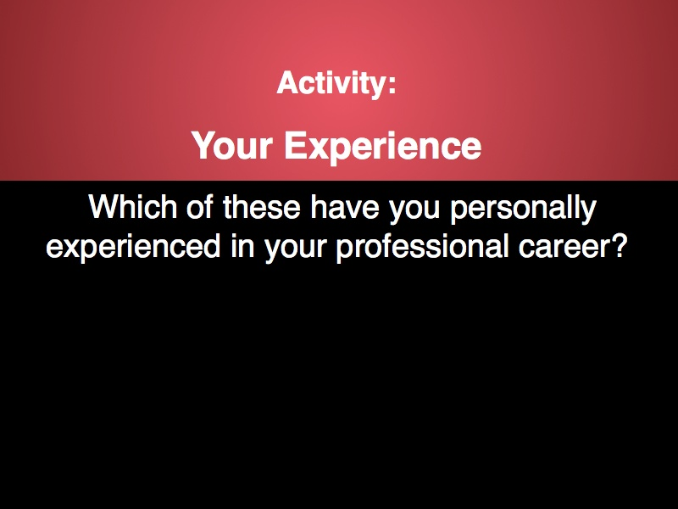

Slide 76
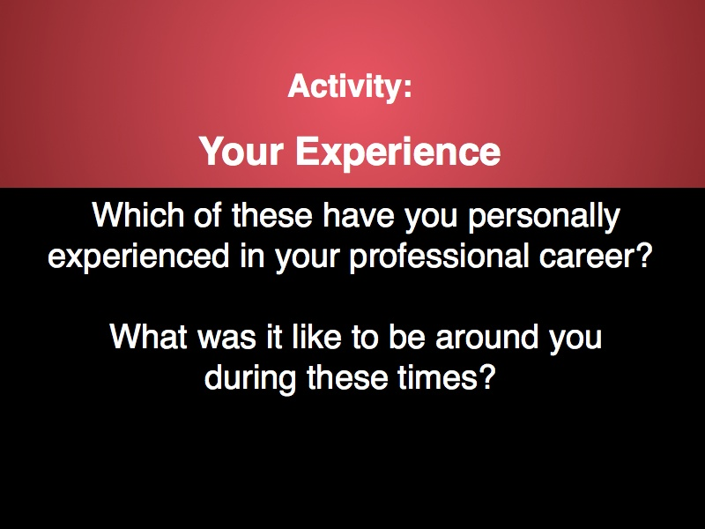

Slide 77
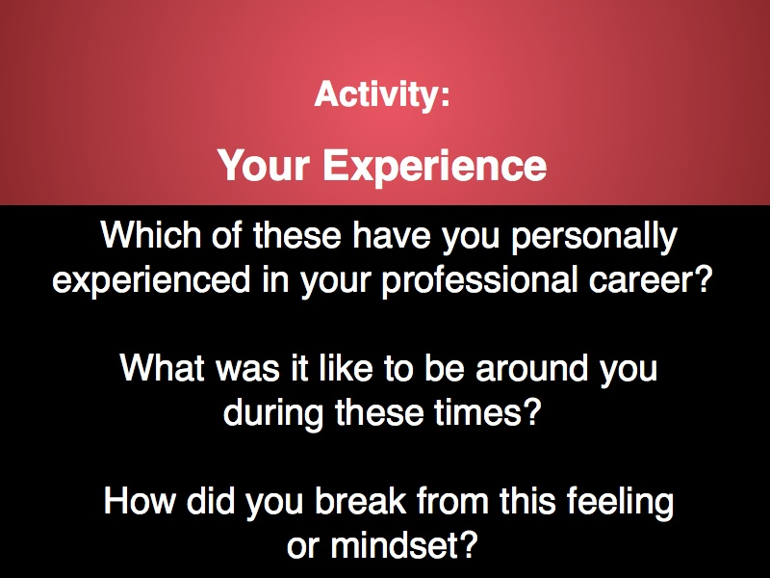

Slide 78


Slide 79


Slide 80


Slide 81


Slide 82


Slide 83
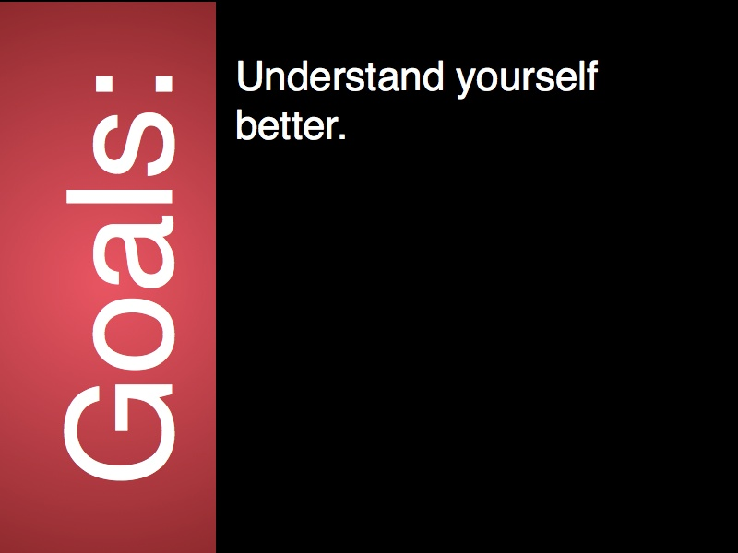

Slide 84
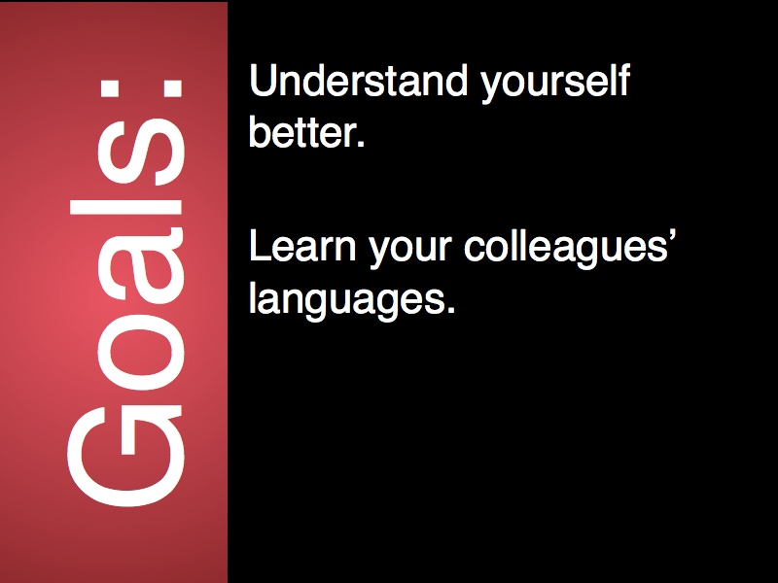

Slide 85
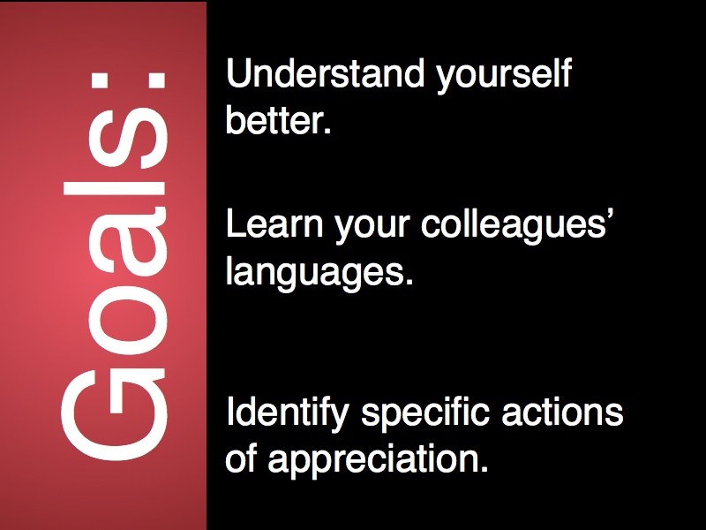

Slide 86


Slide 87
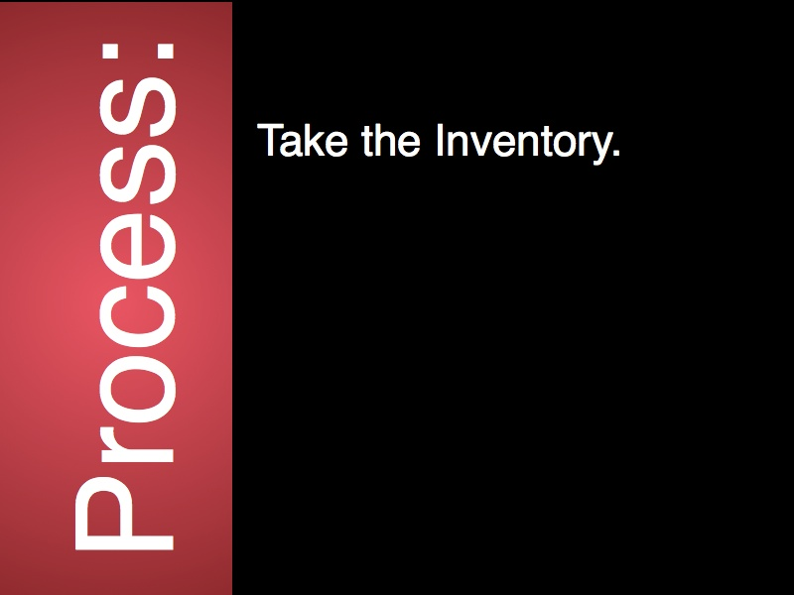

Slide 88
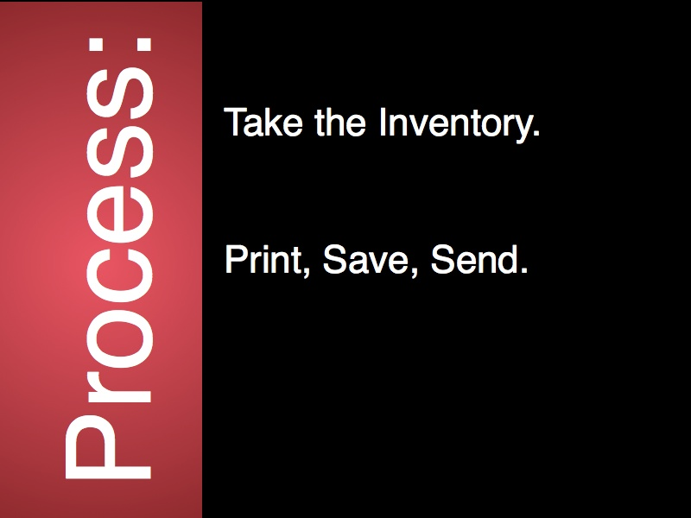

Slide 89
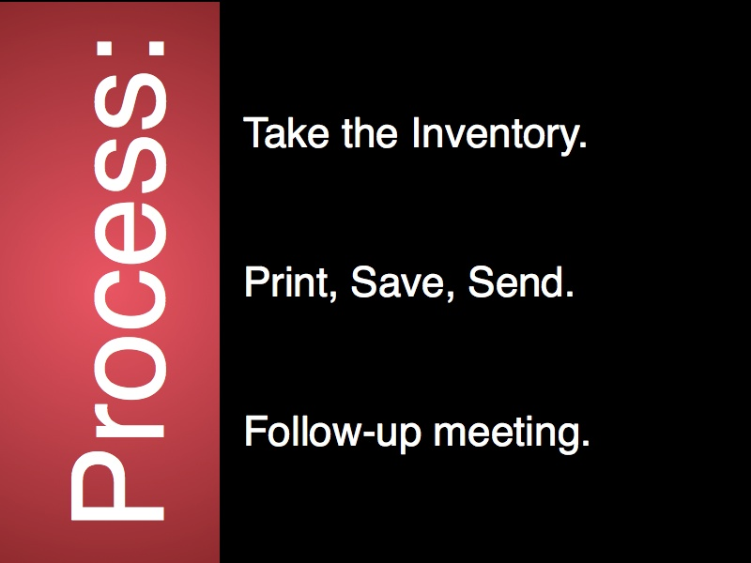

Slide 90
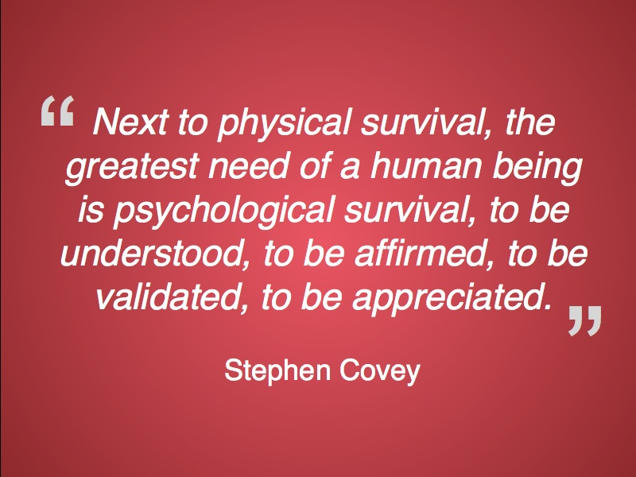

Slide 92
Assignments
Unit 6 Introduction
Man’s Search for Meaning by Victor Frankl
Seven Reason’s Carrots and Sticks Don’t Work by Daniel Pink

